Slide 1

Java Mini Project
AWT & SQLite

Slide 2


Stock Management System
-by
Sankar Abinesh, 1912098
Karthick B, 1912067
Karthick Saran,1912069
Shrijith, 1912105

Slide 3

Project Description
This is a Stock management system, this system develops to control stock management process. Java programming language and SQLite database used to develop this project. Using this system we can add new stock to the database and also we can manage old data stored in data base, this helps in reducing paper work involves in stock management of any place

Slide 4
Source Code : Create Database Code
import java.sql.*;
class createDB
{
public static void main(String a[])
{
Connection c=null;
Statement s=null;
try
{
Class.forName("org.sqlite.JDBC");
c=DriverManager.getConnection("jdbc:sqlite:t2.db");
s = c.createStatement();
String sql = "CREATE TABLE stock (SNAME TEXT, SLEFT INT ,SID INT, SPRICE INT)";
s.executeUpdate(sql);
System.out.println("Databse Created");
s.close();
c.close();
}
catch(Exception e)
{
System.out.println(e);
}
}
}

Slide 5
Source Code : Insert into Database Code
import java.sql.*;
class insert
{
public static void main(String a[])
{
Connection c=null;
Statement s=null;
try
{
Class.forName("org.sqlite.JDBC");
c=DriverManager.getConnection("jdbc:sqlite:t2.db");
String st1="insert into stock values ('Pulses','10','1','30')";
String st2="insert into stock values ('Rice','25','2','45')";
String st3="insert into stock values ('Biscuit','40','3','5')";
s=c.createStatement();
s.executeUpdate(st1);
s.executeUpdate(st2);
s.executeUpdate(st3);
System.out.println("Inserted");
System.out.println("Saved");

Slide 6
Source Code : Insert into Database Code
c.commit();
s.close();
c.close();
}
catch(Exception e){
e.getStackTrace();
}
}
}

Slide 7
Source Code : App Code
import javax.swing.*;
import java.awt.event.*;
import java.sql.*;
import java.util.*;
public class app extends JFrame implements ActionListener {
JLabel Lname, Lid, Lprice, Lleft;
static JTextField Tname, Tid, Tprice, Tleft;
JButton btn;
static JTable jt;
JScrollPane sp;
JFrame f;
static String data[][] = new String[10][4];
String column[]={"ID","NAME","Stock Left","Price"};
app() {
super("View and Insert Stock");
setLayout(null);
Lname = new JLabel("Enter Stock Name:");
Lname.setBounds(20, 20, 150, 20);
add(Lname);

Slide 8
Source Code : App Code
Tname = new JTextField(20);
Tname.setBounds(130, 20, 200, 20);
add(Tname);
Lid = new JLabel("Enter Stock ID:");
Lid.setBounds(20, 40, 150, 20);
add(Lid);
Tid = new JTextField(20);
Tid.setBounds(130, 40, 200, 20);
add(Tid);
Lprice = new JLabel("Enter Stock Price:");
Lprice.setBounds(20, 60, 150, 20);
add(Lprice);
Tprice = new JTextField(20);
Tprice.setBounds(130, 60, 200, 20);
add(Tprice);
Lleft = new JLabel("Enter Stock Left:");
Lleft.setBounds(20, 80, 150, 20);
add(Lleft);

Slide 9
Source Code : App Code
Tname = new JTextField(20);
Tname.setBounds(130, 20, 200, 20);
add(Tname);
Lid = new JLabel("Enter Stock ID:");
Lid.setBounds(20, 40, 150, 20);
add(Lid);
Tid = new JTextField(20);
Tid.setBounds(130, 40, 200, 20);
add(Tid);
Lprice = new JLabel("Enter Stock Price:");
Lprice.setBounds(20, 60, 150, 20);
add(Lprice);
Tprice = new JTextField(20);
Tprice.setBounds(130, 60, 200, 20);
add(Tprice);
Lleft = new JLabel("Enter Stock Left:");
Lleft.setBounds(20, 80, 150, 20);
add(Lleft);

Slide 10
Source Code : App Code
Tleft = new JTextField(20);
Tleft.setBounds(130, 80, 200, 20);
add(Tleft);
btn = new JButton("Submit");
btn.setBounds(130, 100, 100, 20);
btn.addActionListener(this);
add(btn);
jt=new JTable(data,column);
jt.setBounds(100,140,200,300);
sp=new JScrollPane(jt);
sp.setBounds(20,130,400,300);
add(sp);
setVisible(true);
setDefaultCloseOperation(JFrame.EXIT_ON_CLOSE);
setSize(500, 500);

Slide 11
Source Code : App Code
}
public void actionPerformed(ActionEvent e) {
Connection c=null;
Statement s=null;
int row=0;
try {
Class.forName("org.sqlite.JDBC");
c=DriverManager.getConnection("jdbc:sqlite:t2.db");
s=c.createStatement();
String Iname = Tname.getText();
int Iid = Integer.parseInt(Tid.getText());
int Iprice = Integer.parseInt(Tprice.getText());
int Ileft = Integer.parseInt(Tleft.getText());
String query="insert into stock values ('"+Iname+"',"+Ileft+","+Iid+","+Iprice+")";
s.executeUpdate(query);
System.out.println("Inserted");
Connection con = DriverManager.getConnection("jdbc:sqlite:t2.db");
PreparedStatement st = con.prepareStatement("select * from stock");
ResultSet rs = st.executeQuery();

Slide 12
Source Code : App Code
System.out.println(rs);
row=0;
while(rs.next()) {
data[row][1] = (rs.getString(1));
data[row][2] = (rs.getString(2));
data[row][0] = (rs.getString(3));
data[row++][3] = (rs.getString(4));
}
jt=new JTable(data,column);
jt.setBounds(100,140,200,300);
sp=new JScrollPane(jt);
sp.setBounds(20,130,400,300);
add(sp);
Tid.setText(String.valueOf(++row));
Tname.setText("");
Tprice.setText("");
Tleft.setText("");
c.commit();
s.close();
c.close();
}

Slide 13
Source Code : App Code
catch(Exception ee){
ee.getStackTrace();
}
}
public static void main(String args[]) {
int row=0;
try {
Class.forName("org.sqlite.JDBC");
Connection con = DriverManager.getConnection("jdbc:sqlite:t2.db");
PreparedStatement st = con.prepareStatement("select * from stock");
ResultSet rs = st.executeQuery();
System.out.println(rs);
row=0;
while(rs.next()) {
data[row][1] = (rs.getString(1));
data[row][2] = (rs.getString(2));
data[row][0] = (rs.getString(3));
data[row++][3] = (rs.getString(4));
}

Slide 14
Source Code : App Code
} catch (Exception ex) {
System.out.println(ex);
}
new app();
Tid.setText(String.valueOf(++row));
Tid.setEditable(false);
}
}

Slide 15
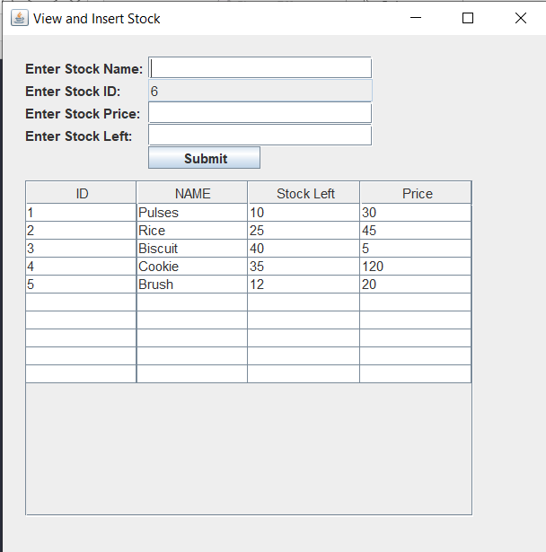
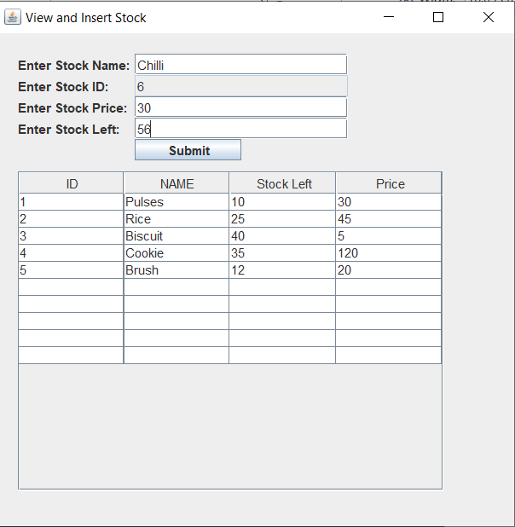
Output:

Slide 16
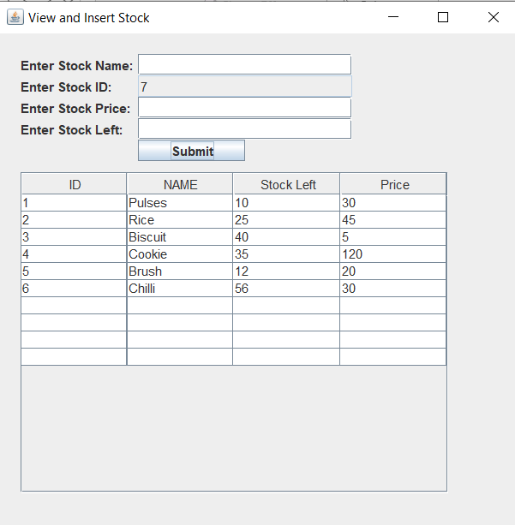
Output:

Slide 17
THANK YOU

